Slide 1
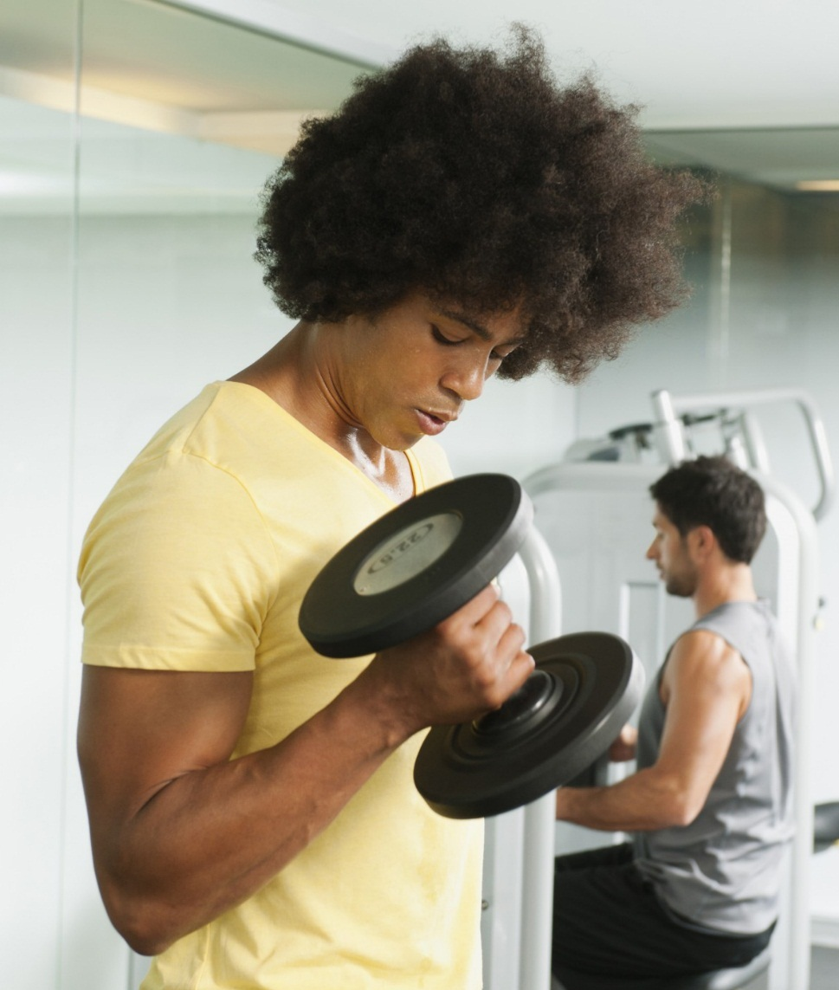
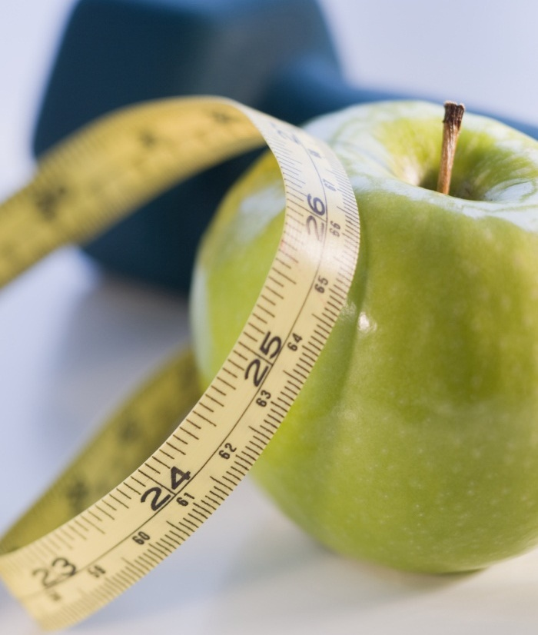

Healthy lifestyle
Prepared By: Aya Mahmoud Mohamed

Slide 2
content
Mission type & statement
What do you think about healthy lifestyle?
Why be healthy?
Why exercise?
How much exercise?
Energy & Food
Healthy Lifestyle Tips
Conclusion

Slide 3
Mission type
Problem solution
motivation

Slide 4
Mission statement
To Create Awareness On The Importance Of Living A Healthy Life

Slide 5
What do you think about healthy lifestyle?

Slide 6
Why be healthy?
Healthy life
Unhealthy life
To live longer, better and happier
Have more energy
Better mental care
Better lifestyle
Avoid disease and illness Keep medical costs down Look and feel better
Poor hygiene
Risky health
Lack of physical activity
Lack of adequate sleep
Spending too much time on social media or watching TV

Slide 7
Why exercise?
Fitness should be a lifestyle, to:
Reduce Health Problems
Boost Brain Functions
Improve Mental Health
Train Discipline
Instill Confidences

Slide 8
how much exercise?
Ideally 20-30 minutes about 4 to 5 times a week
Establish a moderate exercise routine
Make it pleasant not just to lose weight
Do not over do it

Slide 9
Energy
Energy
Water
Food
Energy is needed at all times and is provided through the food we eat

Slide 10

food

Slide 11
Healthy Lifestyle Tips
Avoiding Harmful Activities
Doing Healthy Things You Enjoy.
Taking Care Of Your General Well-being.

Slide 12

thanks. Any Question?!
LIVE HEALTHY..BE HAPPY!
conclusion

